Slide 1


Pizza Sales Analysis using SQL

Slide 2


Pizza Sales Analysis
Objective:
To analyze pizza sales data and uncover insights such as revenue trends, best-selling pizzas, customer preferences, and category performance.
Dataset: Contains order details including pizza ID, name, category, size, price, quantity, and sales amount.
Key Outcomes:
Identify top-selling pizzas and categories
Understand revenue contribution by size and type
Track sales trends over time for business decision-making

Slide 3


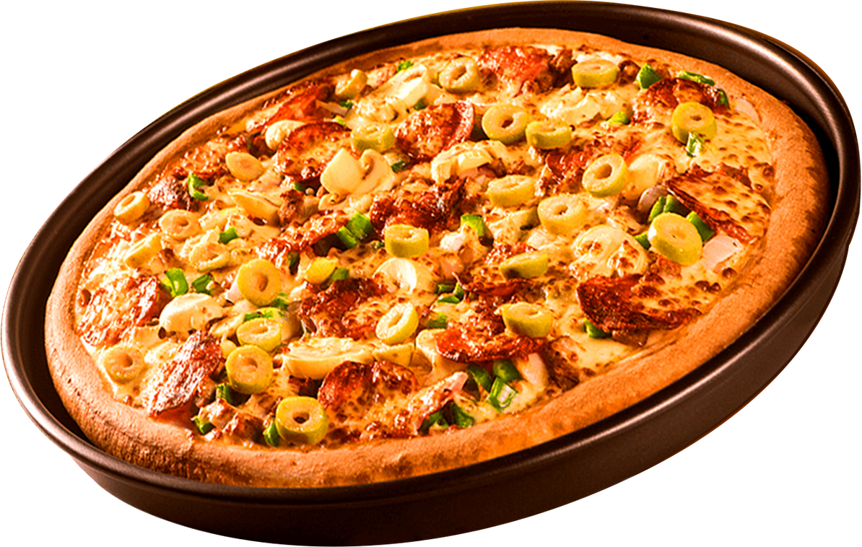

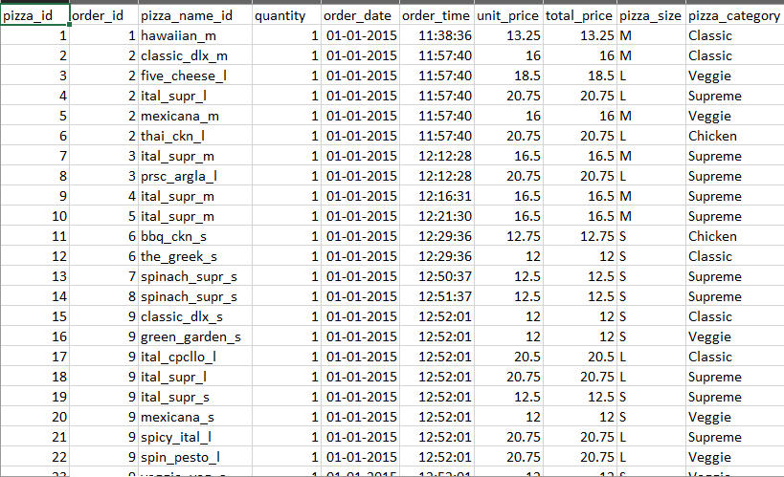
SOURCE
This dataset contains detailed information about pizza orders made by Each record corresponds to an item in an order and includes pizza_id ,order_id,pizza_name_id ,quantity ,order_date ,order_time,unit_price ,total_price,pizza_size ,pizza_category

Slide 4
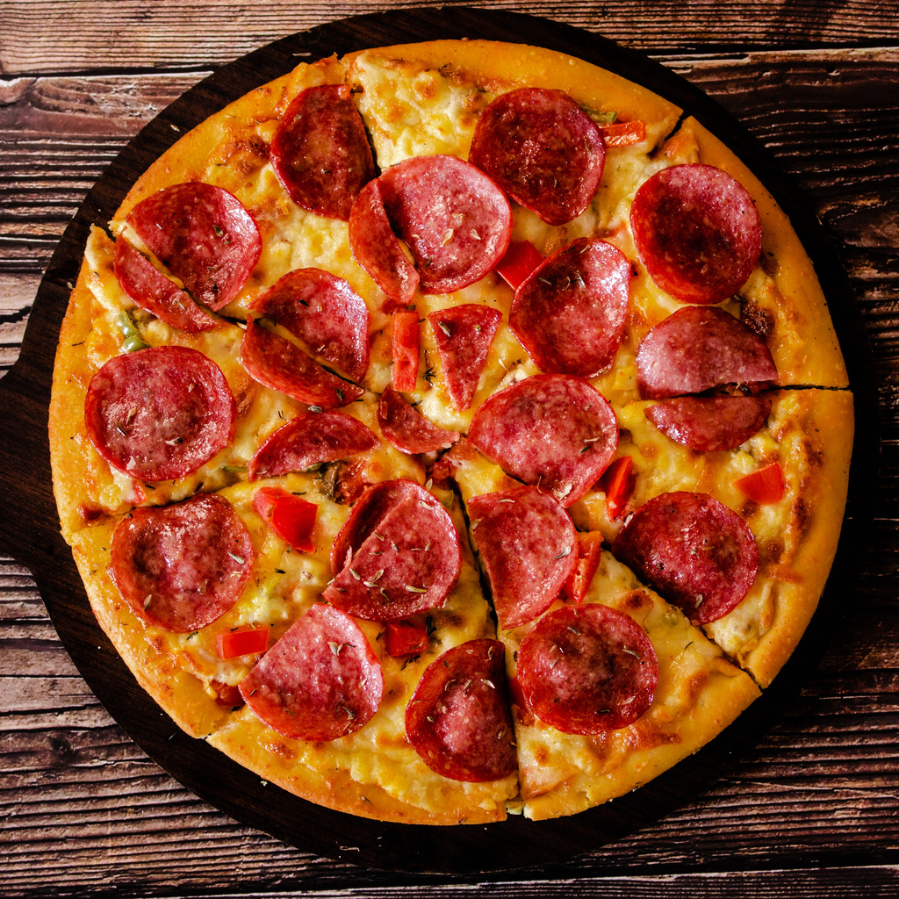

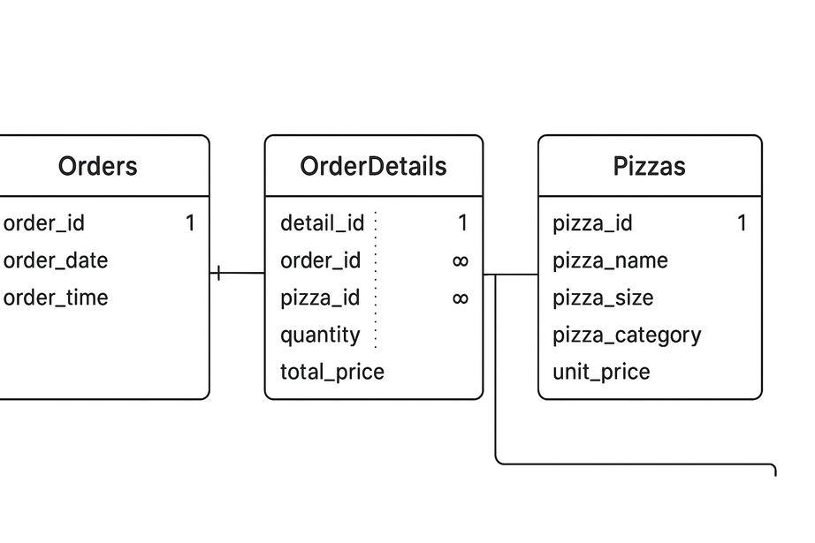


ER DIAGRAM
$6
$6
$6
$6

Slide 5

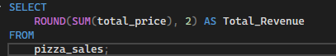
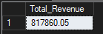
1.Total revenue

Slide 6
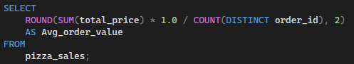
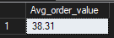
2.Avg Order Value

Slide 7
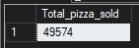
3.tOTAL PIZZAS SOLD

Slide 8
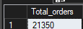
4.tOTAL ORDERS

Slide 9
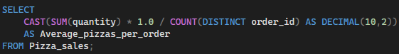
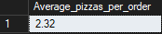
5.AVERAGE PIZZAS PER ORDER

Slide 10
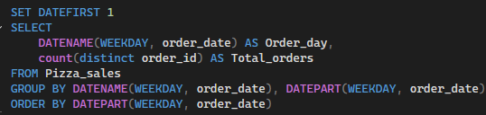
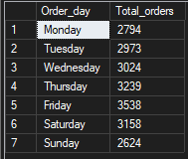
6.DAILY TREND FOR TOTAL ORDERS

Slide 11
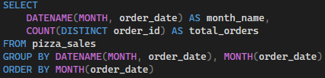
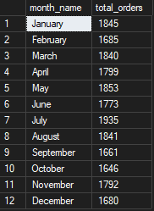
6.MONTHLY TREND FOR TOTAL ORDERS

Slide 12
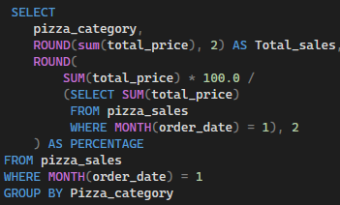
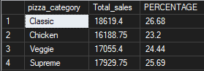
7.Category-wise Revenue Contribution

Slide 13
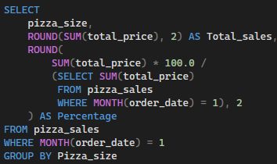
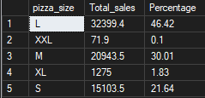
8.SIZE-wise Revenue Contribution

Slide 14
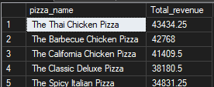
9.Top 5 Pizzas by Sales

Slide 15
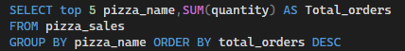
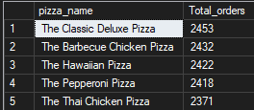
10.Top 5 Pizzas by Total Orders

Slide 16
thank you!

